Slide 1
Welcome to…..
To Predict Customer Churn By Using Different Algorithms

Slide 2
Presented By-
Md Sahrial Alam
Id: 17182103334
MD Sayedur Rahman
17182103297
Md Ikbal Hosen
Id: 17182103317
Khairul Anam Mubin
Id: 17182103286
Supervised By-
DR. Md. Ashraf Uddin
Associate Professor
Department of Computer Science and Engineering (CSE)
Bangladesh University of Business and Technology (BUBT)
Mirpur, Dhaka.
1

Slide 3
Contents
Introduction
Objectives
Proposed Model & Dataset
Data Normalization
Impact Learning
Measure Percentage Before and After Train
Accuracy of Different Algorithm
Limitations & Future Plans
2

Slide 4
Introduction
The Customer Chrun Prediction is to predict how future goes on by present and past result
Use Different algorithm Logistic Regression, Impact Learning, Artificial neural network
Can find better accuracy for that dataset
3

Slide 5
Objectives
Can predicted how many customer give up service and how many customer will stay
Find best accuracy of that data set
Take Customer feedback
Find where is fault for our service
4

Slide 6
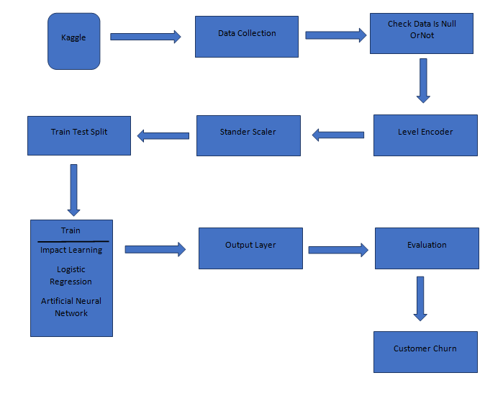
Proposed Model and Dataset
5

Slide 7
Data Normalization
We use is null method for check null value
We use Label Encoder for check value is number or character . If value is character then transform it into number
We use Standard Scaler for shift data range into [0-1]
6

Slide 8
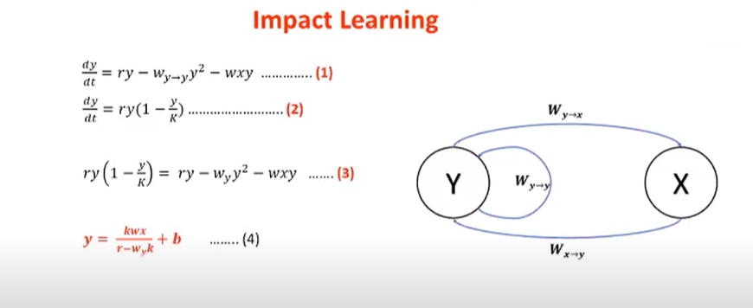
ImpactLearning
Figure: ImpactLearning
7

Slide 9
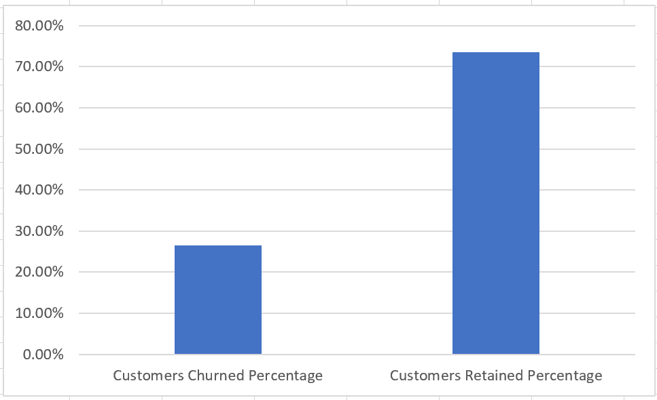
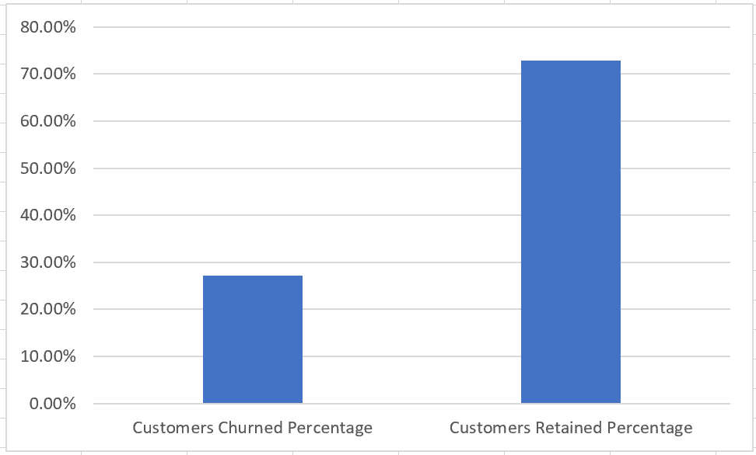
Measure Percentage Before And After Train
Figure: Before Train
Churn 26.537% , Retained 73.463 %
Figure: After Train
Churn 27.165% , Retained 72.834 %
8
Error Rate : 0.628%

Slide 10
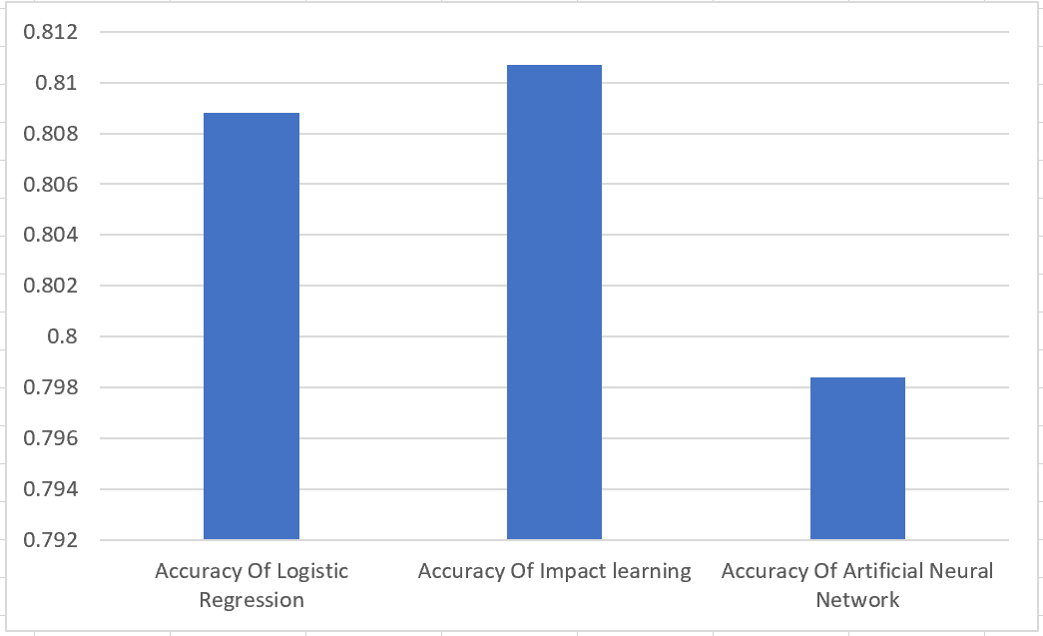
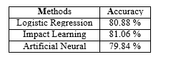
Accuracy of Different Algorithm
9

Slide 11
Limitations & Future Plans
Limitation:
Not best accuracy provide by our algorithm
Plans:
Find more efficient algorithm for that data set
Use More dataset for get more efficient accuracy
10

Slide 12

Thank You Everyone
Any Questions

